Slide 1
COMP2021 Group Project: A Perl Text Classification Tool
Group1
Wan Hanzhe
Huang Tianwei
Poon Kam Lung
Deng Hanyu

Slide 2
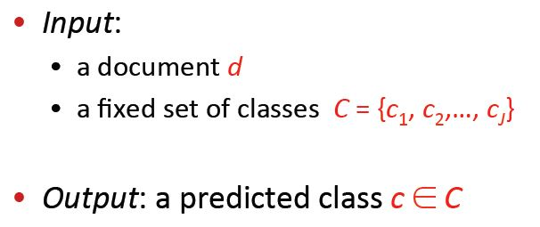
Text Classification: definition

Slide 3
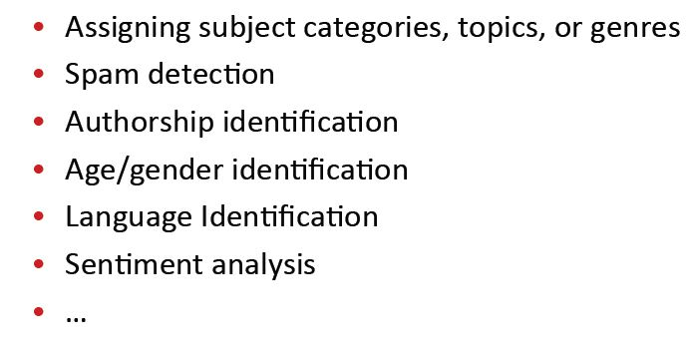
Text Classification: application

Slide 4
Why Perl?
Weka is TOO SLOW…
Perl is PERFECT for text manipulation.
Perl is better at math than Shell Scripting

Slide 5
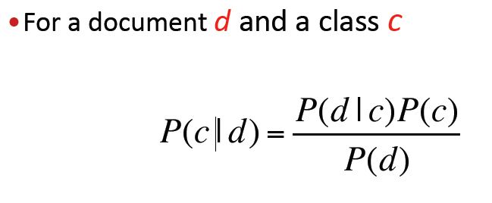

The Methodology : Naïve Bayes

Slide 6
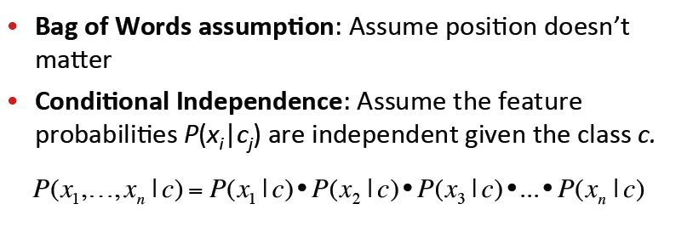
Naïve Bayes: assumptions

Slide 7
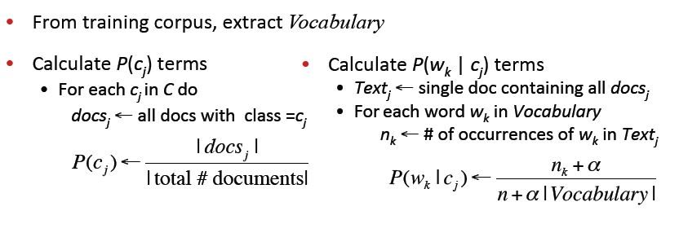
Naïve Bayes: continued

Slide 8
Model Induction: data input
Training Data
Raw Text
Word Vectors
List of Words
Vocabulary
Hash Tables

Slide 9
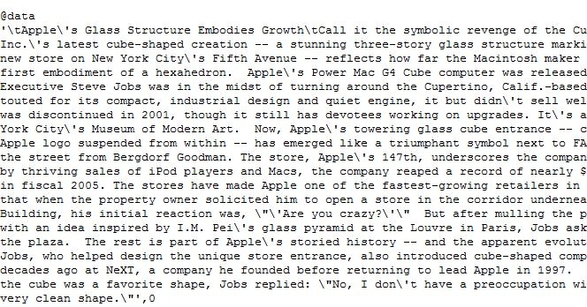
Training Data Example

Slide 10
Model Induction: conditional probability
$$P\left(w_{k} | C_{i}\right)= \frac{Occurance in Class i Text+1}{ Word Count of Class i+1∗Number of different words}$$
Hash : Vocab of Class 1
W1 | W2 | W3 | W4 | W5 | W6 | W7
8 | 12 | 3 | 5 | 2 | 1 | 4
Hash : Vocab of Class 0
W1 | W2 | W3 | W4 | W5 | W6 | W7
4 | 1 | 8 | 0 | 13 | 9 | 0

Slide 11
Model Testing
For any document D including (x1…xn)
Calculate P(C1 | x1….xn) and P(C0 | x1…xn)
D goes to the class with larger probability

Slide 12
Model Evaluation:% of Correctly Classified Items (CCI)

Slide 13
Model Evaluation:% of Correctly Classified Items (CCI)

